Slide 1
Math 769: Statistical Learning

Slide 2
Linear Regression with an Indicator Matrix
Shahrzad Jamshidi, PhD

Slide 3
Last Lecture
Last time, we discussed performing classification using linear regression.
This requires encoding the categories numerically (0, 1, 2, …) and rounding predictions.
We can measure how effective our model is with accuracy, precision, and recall.
We can find decision boundaries, which separate the domain into the classifications estimated by the model.

Slide 4
Objectives
Explain why ordinal encoding may not be ideal.
Define an indicator matrix and encode data using one.
Explain the process of linear regression with this encoding.
Explain how decision boundaries are defined.

Slide 5
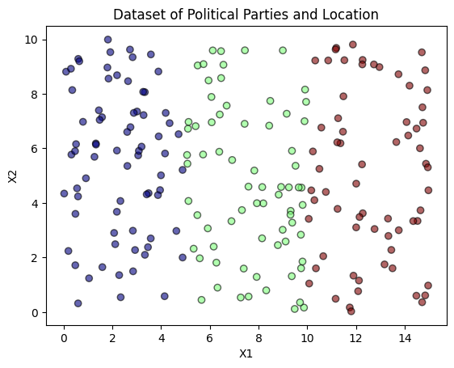
Example from Last Time
Suppose this is our dataset, with the colors indicating the political party
Blue encodes 0
Green encodes 1
Red encodes 2

Slide 6
What is a problem with this encoding?
Notes:
This is where the linear algebra comes in

Slide 7
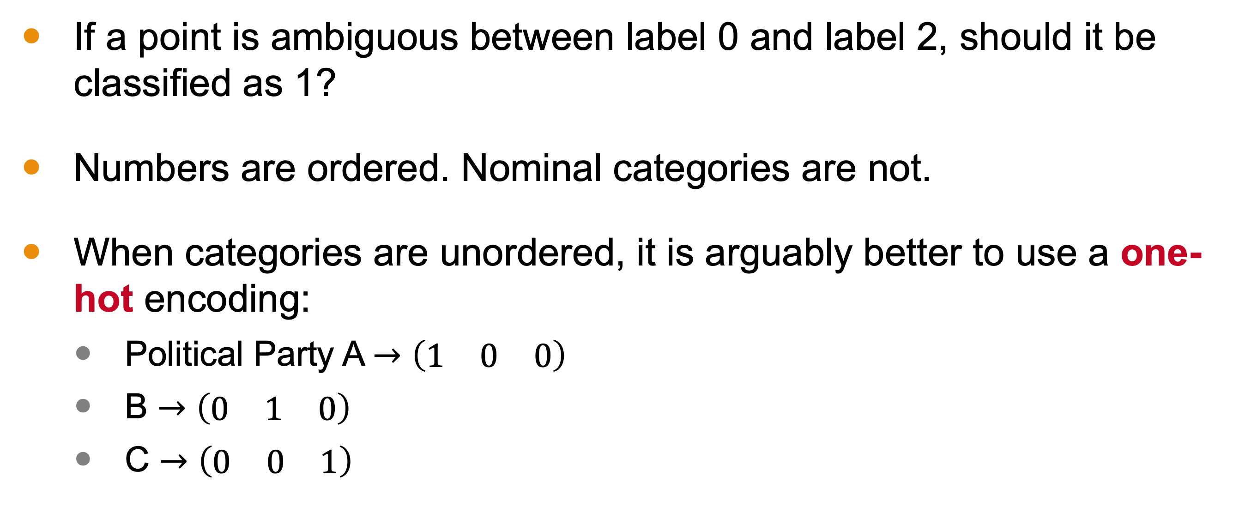
Ordinal vs. Nominal Categories
If a point is ambiguous between label 0 and label 2, should it be classified as 1?
Numbers are ordered. Nominal categories are not.
When categories are unordered, it is arguably better to use a one-hot encoding:
Political Party A $→\left(\begin{matrix}1 & 0 & 0\end{matrix}\right)$
B $→\left(\begin{matrix}0 & 1 & 0\end{matrix}\right)$
C $→\left(\begin{matrix}0 & 0 & 1\end{matrix}\right)$

Slide 8
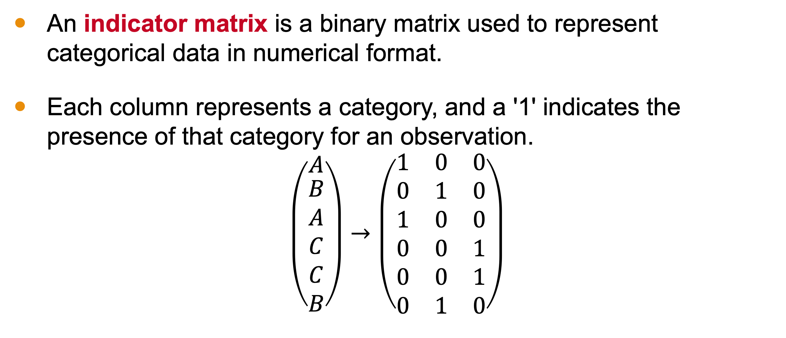
Indicator Matrix
An indicator matrix is a binary matrix used to represent categorical data in numerical format.
Each column represents a category, and a '1' indicates the presence of that category for an observation.
$$\left(\begin{matrix}A \\ \begin{aligned}B \\ A \\ C \\ C \\ B\end{aligned}\end{matrix}\right)→\left(\begin{aligned}\begin{matrix}1 & 0 & 0\end{matrix} \\ \begin{matrix}0 & 1 & 0\end{matrix} \\ \begin{matrix}1 & 0 & 0\end{matrix} \\ \begin{matrix}0 & 0 & 1\end{matrix} \\ \begin{matrix}0 & 0 & 1\end{matrix} \\ \begin{matrix}0 & 1 & 0\end{matrix}\end{aligned}\right)$$

Slide 9
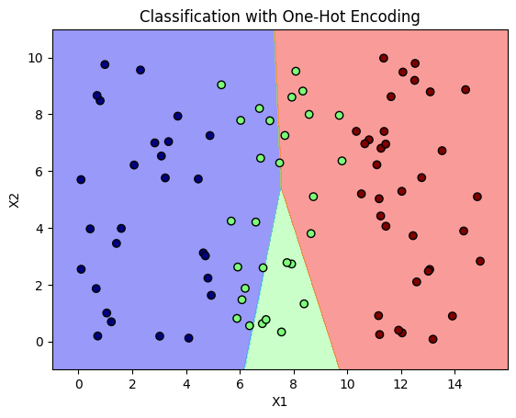
How Is this Different?
The categories are encoded in an *unordered* way
We perform linear regression for each category.
k categories means k linear equations
We classify with the highest valued category.

Slide 10
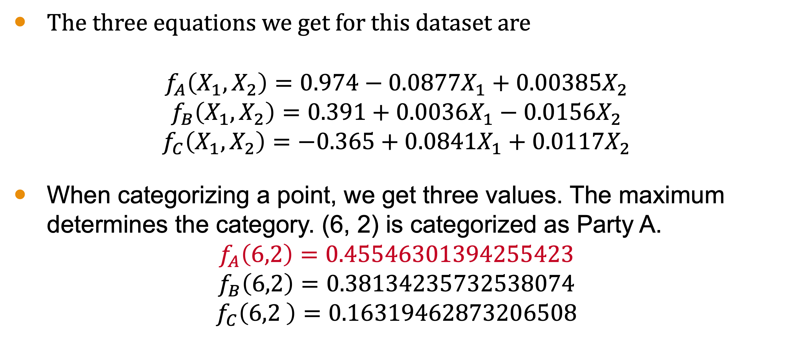
Three Equations
The three equations we get for this dataset are
$$f_{A}\left(X_{1},X_{2}\right)=0.974−0.0877X_{1}+0.00385X_{2}$$
$$f_{B}\left(X_{1},X_{2}\right)=0.391+0.0036X_{1}−0.0156X_{2}$$
$$f_{C}\left(X_{1},X_{2}\right)=−0.365+0.0841X_{1}+0.0117X_{2}$$
When categorizing a point, we get three values. The maximum determines the category. (6, 2) is categorized as Party A.
$$f_{A}\left(6,2\right)=0.45546301394255423$$
$$f_{B}\left(6,2\right)=0.38134235732538074$$
$$f_{C}\left(6,2 \right)=0.16319462873206508$$

Slide 11
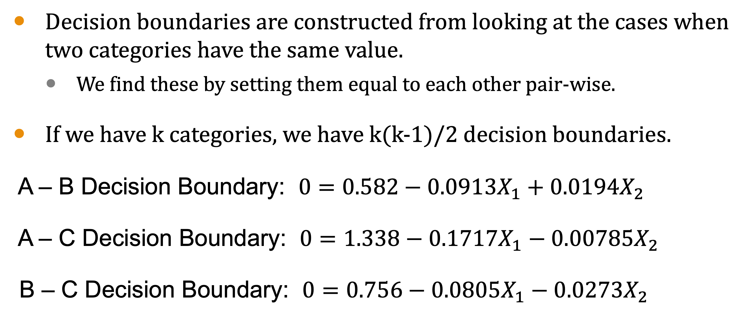
Decision boundaries
Decision boundaries are constructed from looking at the cases when two categories have the same value.
We find these by setting them equal to each other pair-wise.
If we have k categories, we have k(k-1)/2 decision boundaries.
A – B Decision Boundary: $0=0.582−0.0913X_{1}+0.0194X_{2}$
A – C Decision Boundary: $0=1.338−0.1717X_{1}−0.00785X_{2}$
B – C Decision Boundary: $0=0.756−0.0805X_{1}−0.0273X_{2}$

Slide 12
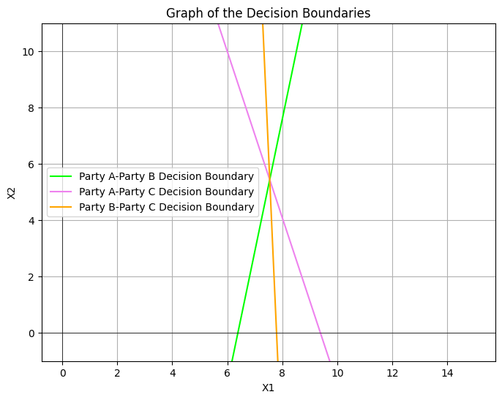
Decision Boundaries
The categories of the regions between the lines can deduced from what we know.

Slide 13
Decision Boundaries
Deductions give rise to the following regions.
The points depicted at the testing set.
We can find accuracy, precision, and recall to determine how good our model is.

Slide 14
Evaluation of the Model
Accuracy: 0.7444
Precision:
A: 27 / 41 = 0.65
B: 6 / 6 = 1
C: 34 / 43 = 0.79
Recall:
A: 27 / 27 = 1
B: 6 / 29 = 0.21
C: 34 / 34 = 1
Act\Pred | A | B | C
A | 27 | 0 | 0
B | 14 | 6 | 9
C | 0 | 0 | 34

Slide 15
Conclusion
One-hot encoding allows for a numerical encoding that is unordered.
We need to perform as many regressions as there are categories for the output.
If there are k categories, there are k(k-1)/2 decision boundaries to compute.
We can use standard classification metrics to evaluate the model.

